Slide 1
Chemical Kinetics
UNIT V, BSc III year
Topics : Basics concept of chemical kinetics, stoichiometry, factors affecting rate of reaction

Slide 2
Chemical Kinetics
Kinetics – how fast does a reaction proceed?
Thermodynamics – does a reaction take place?
Reaction speed: measured by the change in concentration with time.
Important factors which affect rates of reactions:
  reactant concentration
  temperature
  action of catalysts
  surface area
  pressure of gaseous reactants or products

Slide 3
Kinetics
Studies the rate at which a chemical process occurs.
Besides information about the speed at which reactions occur, kinetics also sheds light on the reaction mechanism (exactly how the reaction occurs).

Slide 4
Outline: Kinetics
Reaction Rates | How we measure rates.
Rate Laws | How the rate depends on amounts of reactants.
Integrated Rate Laws | How to calculate amount left or time to reach a given amount.
Half-life | How long it takes to react 50% of reactants.
Arrhenius Equation | How rate constant changes with temperature.
Mechanisms | Link between rate and molecular scale processes.

Slide 5
Reaction Rate
For the reaction A → B there are two ways of measuring rate:
  (1) the speed at which the reactants disappear
  (2) the speed at which the products appear
Reversible reactions: as products accumulates, they can begin to turn back into reactants.
Early on the rate will depend on only the amount of reactants present. We want to measure the reactants as soon as they are mixed.
A general way of measuring the rate of the reaction is in terms of change in concentration per unit time…
  Instantaneous rate = ∆[A]/∆t limits to d[A]/dt
  Most Common Units… Rate = M/s
  Where Molarity (M) = moles/Liter

Slide 6
Chemical Kinetics
Reaction rate is the change in the concentration of a reactant or a product with time (M/s).
A B
Δ[A]
Δ[A] = change in concentration of A over
time period Δt
rate = -
Δt
Δ[B]
Δ[B] = change in concentration of B over
time period Δt
rate =
Δt
Because [A] decreases with time, Δ[A] is negative.

Slide 7
Reaction Rates and Stoichiometry
To generalize, for the reaction
aA + bB
cC + dD
Reactants (decrease)
Products (increase)

Slide 8
Here’s another way of looking at reaction rates…
2N₂O_{5(g)} → 4NO_{2(g)} + O_{2(g)}
Notice that for every 1 mole of O₂ that appears, 4 x as many moles of NO₂ will also appear. In the meantime, twice as many moles of N₂O₅ will be disappearing as moles of O₂ forming.
However, the same reaction cannot have 3 different rates…
In stead, we write the rate of the reaction as follows:
Reaction Rate = −½ ∆ [N₂O₅]/∆t = ¼ ∆[NO₂]/∆t = ∆[O₂]/∆t
(i.e., rate of change in concentration divided by respective stoichiometric coefficient)

Slide 9
Factors Affecting Reaction Rate Constants

Slide 10
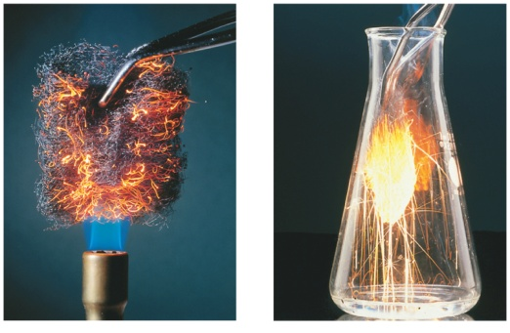
Factors that Affect the Reaction Rate Constant
Temperature: At higher temperatures, reactant molecules have more kinetic energy, move faster, and collide more often and with greater energy
  Collision Theory: When two chemicals react, their molecules have to collide with each other (in a particular orientation) with sufficient energy for the reaction to take place.
  Kinetic Theory: Increasing temperature means the molecules move faster.
Concentrations of reactants
  As the concentration of reactants increases,
  so does the likelihood that reactant molecules will collide.
Catalysts
  Speed up reactions by lowering activation energy
Surface area of a solid reactant
  More area for reactants to be in contact
Pressure of gaseous reactants or products
  Increased number of collisions

